Slide 1
FiFA World Cup AnalYsis
Made by – Joymalya Biswas
Reg no. - 11704276

Slide 2
INTRODUCTIOn
The analytics team of the Football World Cup association and FIFA association anywhere in the world would love to check our through data analysis of each and every match leading to a well-organized and fruitful information.
My analysis contains data on host teams, all stadiums, most supported team and teams which are most successful

Slide 3
FIFA WORLD CUP ANALYSIS contains the following data fields: -
Year – The year on which the following match is held.
Date Time – Contains date and time on which the match is held.
Stage – The level as Group A, B, C, D etc.
Stadium – Stadium in which match is held.
City – City in which match is held.
Home Team Name – Host team name.
Home team Goals – No of goals scored by the home team
Away team goals – No of goals scored by the away team.
Away team name – Away team name.
Attendance – no. of people coming to enjoy the particular match.
Half time home goals – goals scored by the home team by half time.
Half time away goals – goals scored by the away team by half time.
Referee – Name of referee
Assistant 1 – Name of Assistant 1
Assistant 2 – Name of assistant 2
Home team initials – 3-word initials
Away team initials - 3-word initials
Winner – Winner team
Total Goals – Total goals scored

Slide 4
Analytics team wishes to answer the following objectives: -
Half time goals scored by the home and away team year wise.
No of goals scored in finals until now.
Analyzing the total attendance of crowd in Group matches, semifinals and Finals.
Overall Attendance for a particular city until now.
No. of people came to view match for particular team.
Country winning the maximum World Cups.
Goals scored by home teams and away team
Analyzing difference between total goals scored and total goals conceded by teams

Slide 5
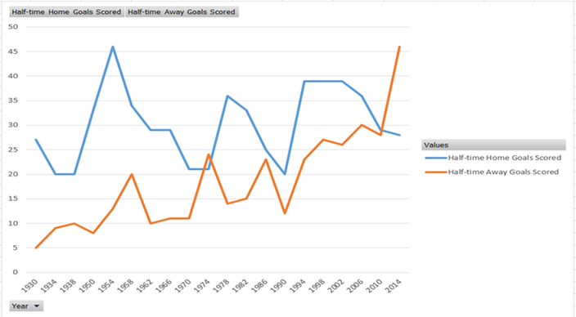
Half Time goals scored by the home and away teams:
The half time goals scored by the home teams were a lot higher then that of away team as they have a better understanding of ground.

Slide 6
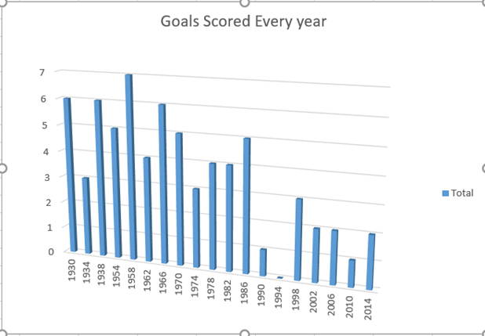
No of goals scored in finals until now
Until now 69 goals are scored in finals and most of the time host team have won just 1-time draw have happened in finals and once a 0 scored match.

Slide 7
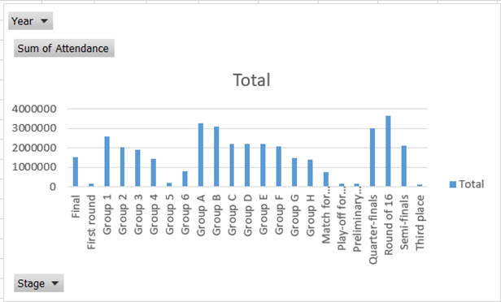
Analyzing the total attendance of crowd in group matches, Semi-Finals and Finals
Most Crowded stadiums are present in the semifinals then comes finals after that group stages match so book a stadium acc. to that.

Slide 8
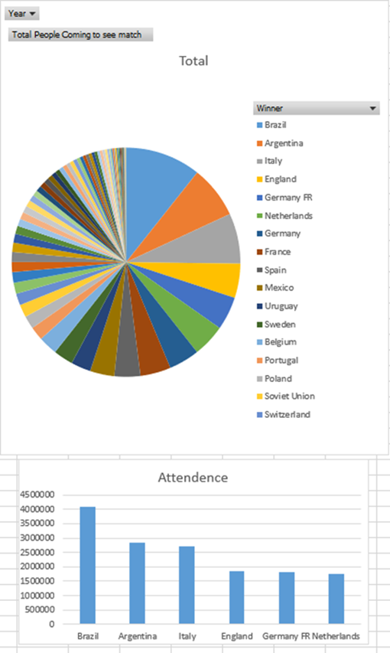
Number of people came to view match for a particular team
Most people came to see match for brazil then argentina,Italy England and so on..

Slide 9
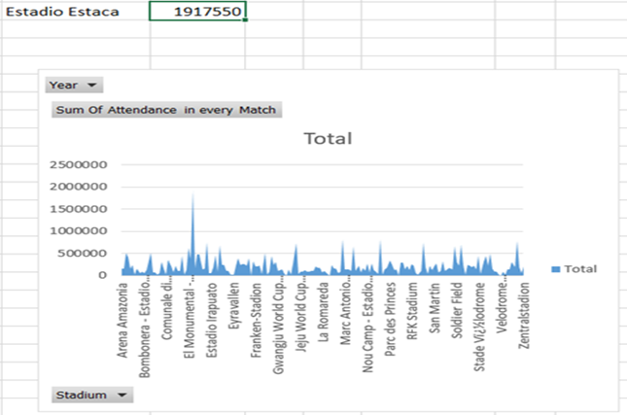
Overall attendance for a particular city until now
Most attendance is there for Estadio Estaca and so on

Slide 10
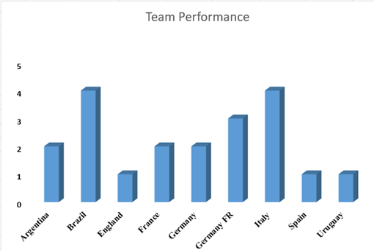
Country winning the maximum world cups
Maximum world cup is won by brazil and Italy together as 4 then comes Germany at 3 and then comes Argentina at 2.

Slide 11
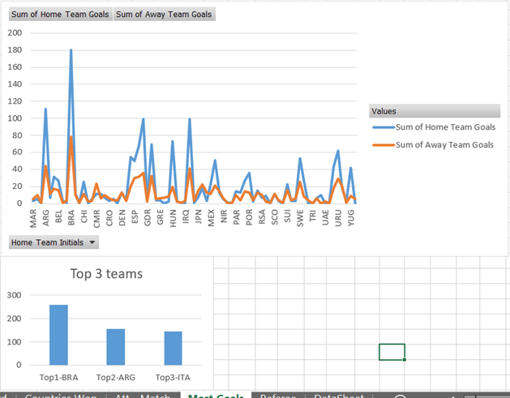
Goals Scored by home teams and away teams

Slide 12
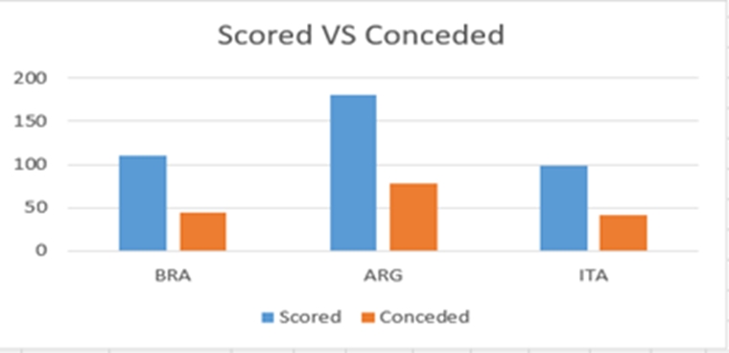
Analyzing difference between total goals scored and total goals conceded
Top 3 teams have large difference between scored and conceded that show their superiority over other teams

Slide 13
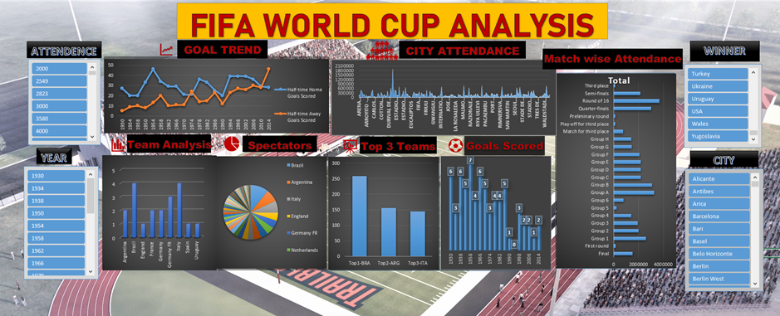
Final Dashboard

Slide 14
Thank you

